Slide 1
Are you moving predictably?
Clustering of movement data in Medellín
Notes:
-Greetings
-read out loud the title

Slide 2

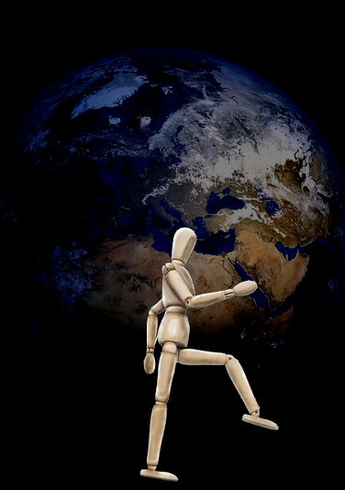

Notes:
-Are you deterministic?
-can we predict your social status based on your movement?

Slide 3
Zusammenfassung der Daten
Welche Attribute
Verteilung
Ziel des Clusterings
Strata reproduzieren
6 Stratas
Mehrere Zusammengefasst
Eigenes Cluster finden
Was haben wir gemacht
Testdaten ( Verteilung und Vector)[Python]
Rapidminer
Clustering [Gower]
PCA[Zeitgewinn aber selbes Erg.]
Decision Tree
NN
Was haben wir nun?

Slide 4
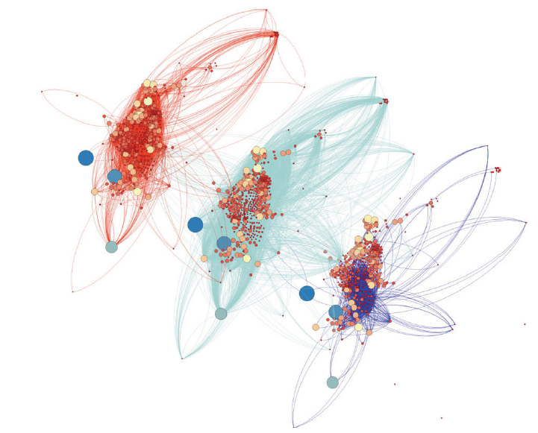
Problem definition
„Based on the paper of Loter et al. we analyzed the movement data of Medellín. Their movements, of six socio-economic groups, are given with, for example, the endpoints of travelling, reason, or means of transportation, as well as personal information, like gender or age.
The task is to find dependencies between these entries and the socio-economic group of that person.“
Lotero, Laura, et al. "Rich do not rise early: spatio-temporal
patterns in the mobility networks of different socio-economic classes."
Notes:
Medellín, Columbia
strata is explained from the city and also used for pay taxes
Have differend data

Slide 5
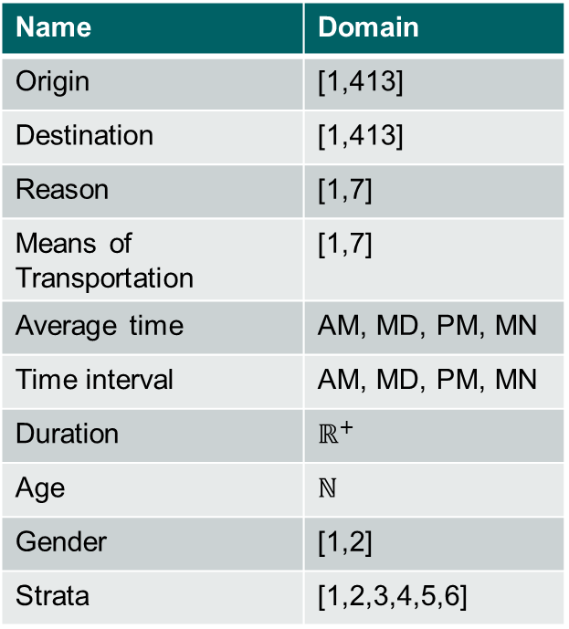
Available Data – What does it look like?
Name | Domain
Origin | [1,413]
Destination | [1,413]
Reason | [1,7]
Means of Transportation | [1,7]
Average time | AM, MD, PM, MN
Time interval | AM, MD, PM, MN
Duration | $$ℝ^{+}$$
Age | ℕ
Gender | [1,2]
Strata | [1,2,3,4,5,6]
Notes:
Origin, Destination are sectors of the city (DON’T say nodes, please)
Reasons: school, work
MoT: Bike, Car, Bus

Slide 6

Aim of investigation – What should we do?
Reproduce the stratas
Aggregated stratas
Look for own clusters
?
Data
Cluster
Strata
Strata 1-2
Strata 3-4
Strata 5-6
Strata 1
Strata 3
Strata 5
Strata 2
Strata 4
Strata 6
Notes:
Compare clusters with strata -> be more precies
Too fine classification?
Different visualizations
How is the clustering measured
This is the index -> numbers and saying that we will explain this the rest of the presentation more in detail

Slide 7
Procedure – What was our methodology?
1
2
3
4
Evaluate results and adapt process
Take a look at the data
Investigate distance measures and data distribution
Run Clustering algorithms

Slide 8
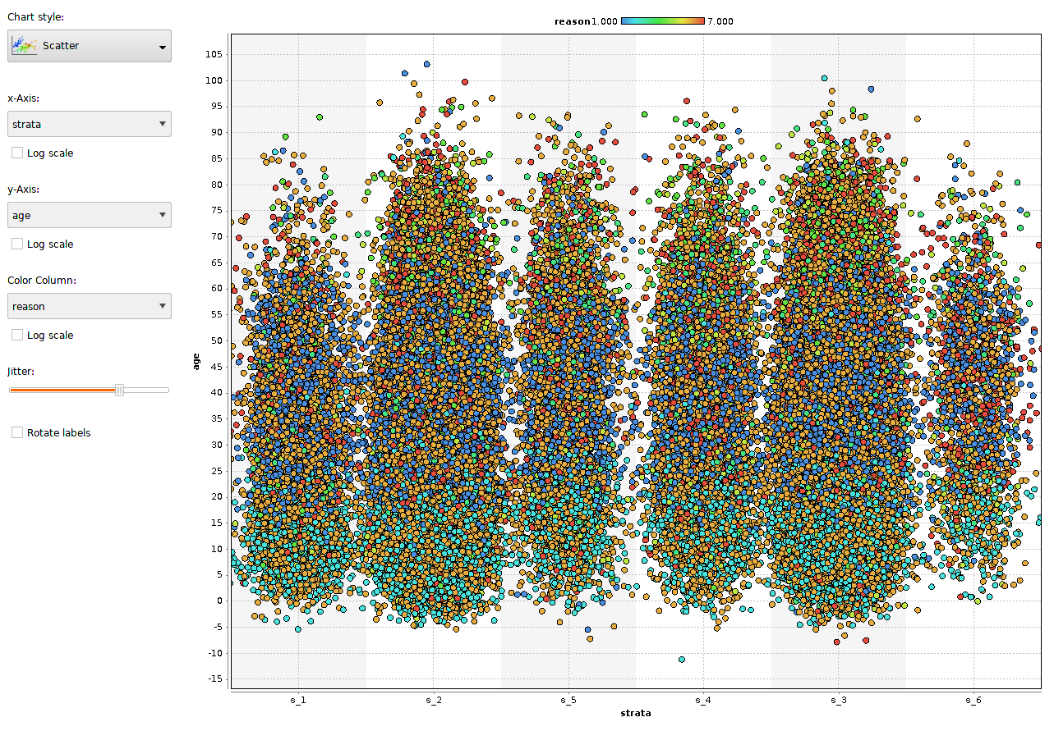
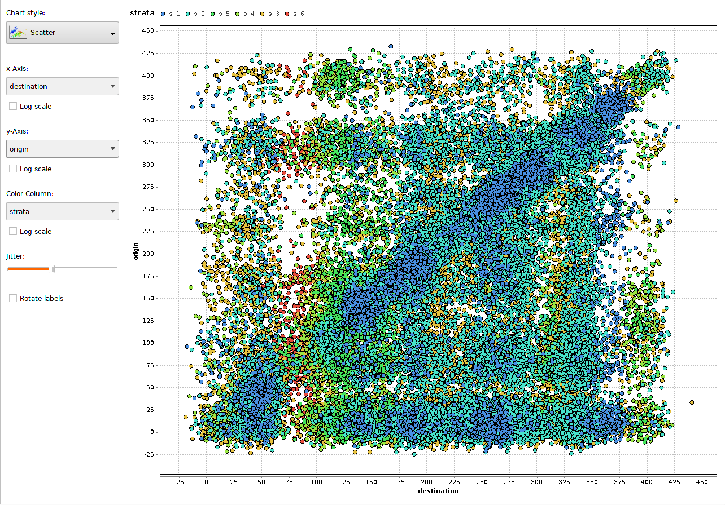
Dig in data – Can we see something?
Notes:
Just for having an idea

Slide 9
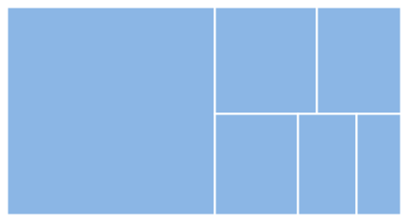
Procedure – What have we done?
Testdata-Generator
Equal distribution
Resize dataset
Notes:
Equal good for training
Strata 6 has lowest portion
Resize to optimize

Slide 10
Encountered Problem
Movement 1
Movement 3
Movement 5
Movement 2
Movement 4
Notes:
More details with explanation!
Changing movements to lines of data and connnect them with the persons

Slide 11
Encountered Problem
Data
Origin | Dest. | … | Gender | Age | Strata
1 | 5 | … | 1 | 45 | 3
5 | 35 | … | 1 | 45 | 3
35 | 1 | … | 1 | 45 | 3
14 | 25 | … | 0 | 20 | 2
… | … | … | … | … | …
Notes:
3 Lines in Data => 3 People
If consecutive and same Gender, Age, Strata => same Person

Slide 12
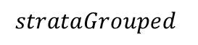
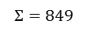
Procedure – What have we done?
Testdata-Generator
Vector data set/Dummy Variable
Aggregated vector data set
$$o_{1},…{,o}_{413},d_{1},…{,d}_{413},AM,MD,PM,MN,r_{1},…{,r}_{7},MoT_{1},…,MoT_{7},S_{Dest}, S_{Dist},G, A, strata$$
413
413
4
7
7
5
$$Σ=849$$
Also add:
$$strataGrouped$$
Strata 1-2
Strata 3-4
Strata 5-6
Strata 1
Strata 3
Strata 5
Strata 2
Strata 4
Strata 6
Notes:
Dummy variable
Value = sum of persons movements

Slide 13
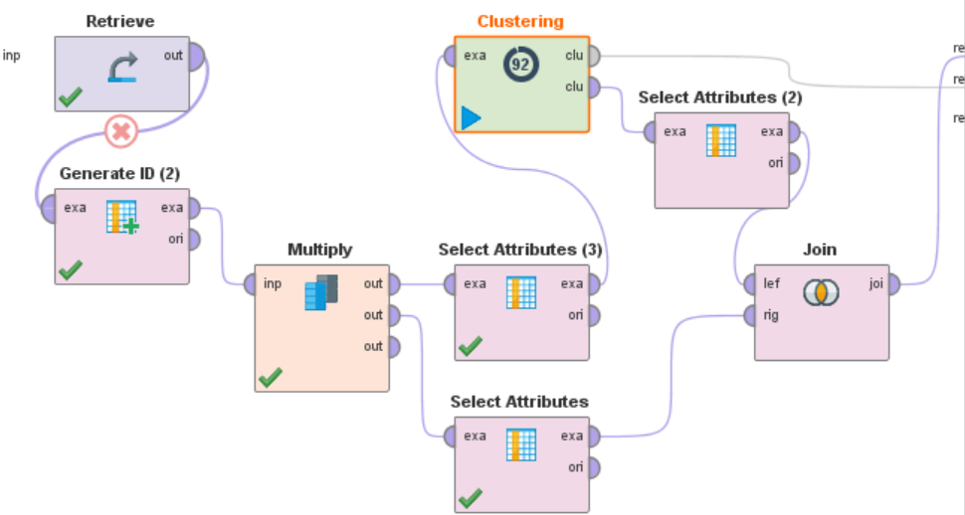
Rapidminer
k-means clustering

Slide 14
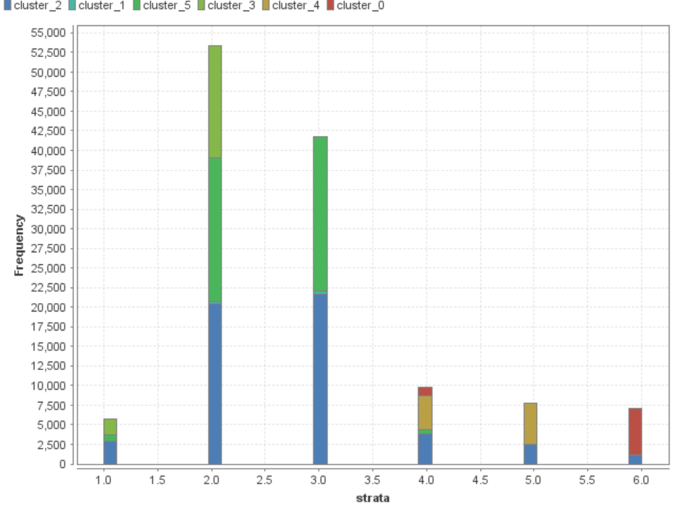
Rapidminer
k-means clustering
Notes:
For measuring also dist2038eq foto

Slide 15
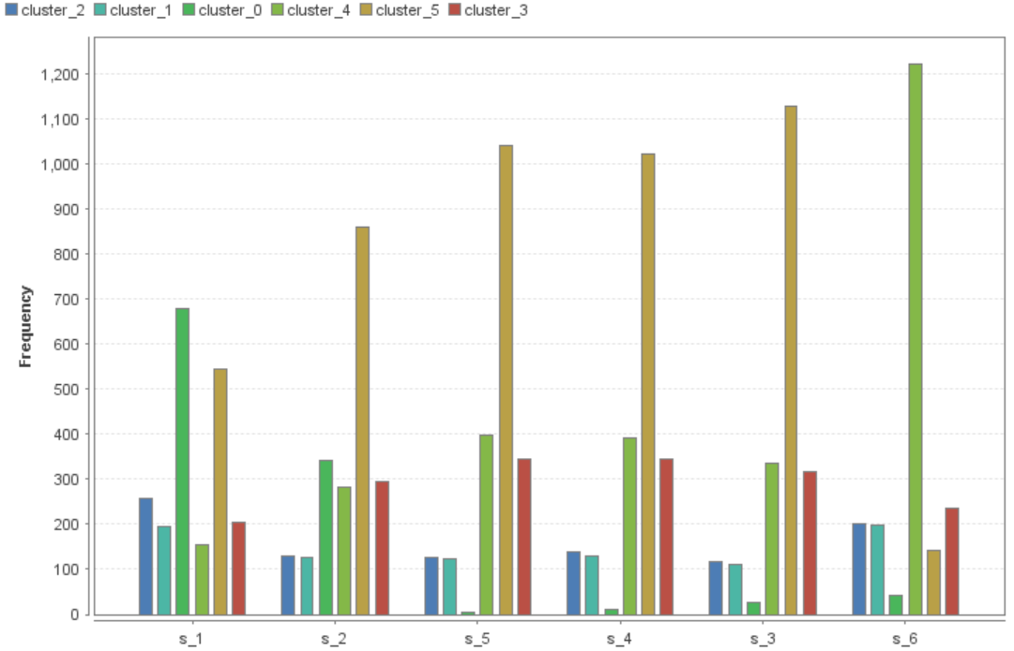
Rapidminer
Notes:
Equally distributed 2038 in every strata

Slide 16
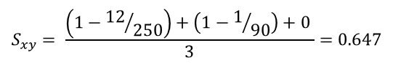
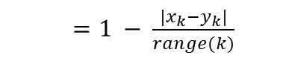
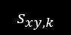
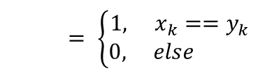
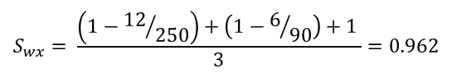
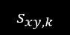
Gower Distance
Example:
Similarity score based on variable type
 | travelDist | age | gender
w | 87 | 40 | M
x | 98 | 46 | M
y | 110 | 45 | F
z | 16 | 25 | F
Binary (irrelevant for our data)
Categorical
Numerical
$= \left\{\begin{aligned}1, x_{k}==y_{k} \\ 0, else \end{aligned}\right.$
$$s_{xy,k}$$
$$S_{wx}= \frac{\left(1−{12}/{250}\right)+\left(1−6/{90}\right)+1 }{3}=0.962$$
$=1 − \frac{|x_{k}−y_{k}|}{range(k)}$
$$s_{xy,k}$$
$$S_{xy}= \frac{\left(1−{12}/{250}\right)+\left(1−1/{90}\right)+0 }{3}=0.647$$
$range(k)$ depicts the range of relevant values for variable $k$, e.g. age $∈\{0, …,90\}$
Notes:
Man sieht, welchen starken Einfluss kategorische Variablen (wie gender) haben. Die Similarity von x,y ist recht gering, trotz ähnlicher Werte. Die Punkte y,z sind sich laut gower ähnlicher, obwohl im Grunde nur das Geschlecht wirklich übereinstimmt.

Slide 17
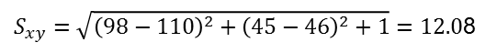
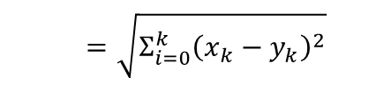
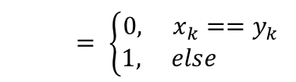
Mixed Euclidean Distance (MED)
Example:
similarity score based on variable type
 | travelDist | age | gender
w | 87 | 40 | M
x | 98 | 46 | M
y | 110 | 45 | F
z | 16 | 25 | F
Binary (irrelevant for our data)
Categorical
Numerical
$= \left\{\begin{aligned}0, x_{k}==y_{k} \\ 1, else \end{aligned}\right.$
$$s_{xy,k}$$
$$S_{wx}=\sqrt{{\left(87−98\right)}^{2}+{\left(40−46\right)}^{2}+0}=13.42$$
$=\sqrt{Σ_{i=0}^{k}{\left(x_{k}−y_{k}\right)}^{2}}$
$$s_{xy,k}$$
$S_{xy}=\sqrt{{\left(98−110\right)}^{2}+{\left(45−46\right)}^{2}+1}=12.0$8
$range(k)$ depicts the range of relevant values for variable $k$, e.g. age $∈\{0, …,90\}$
Notes:
Man sieht, welchen starken Einfluss kategorische Variablen (wie gender) haben. Die Similarity von x,y ist recht gering, trotz ähnlicher Werte. Die Punkte y,z sind sich laut gower ähnlicher, obwohl im Grunde nur das Geschlecht wirklich übereinstimmt.

Slide 18
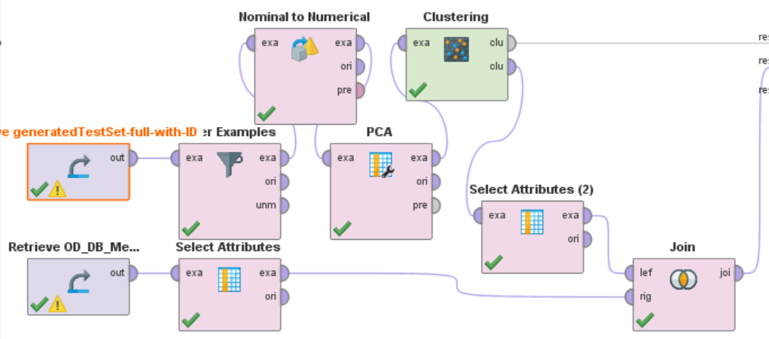
Rapidminer
PCA k-means clustering
Notes:
Principal component analysis -> reduce dimensionality of dataset
Nominal to numerical -> binary in 4 rows

Slide 19
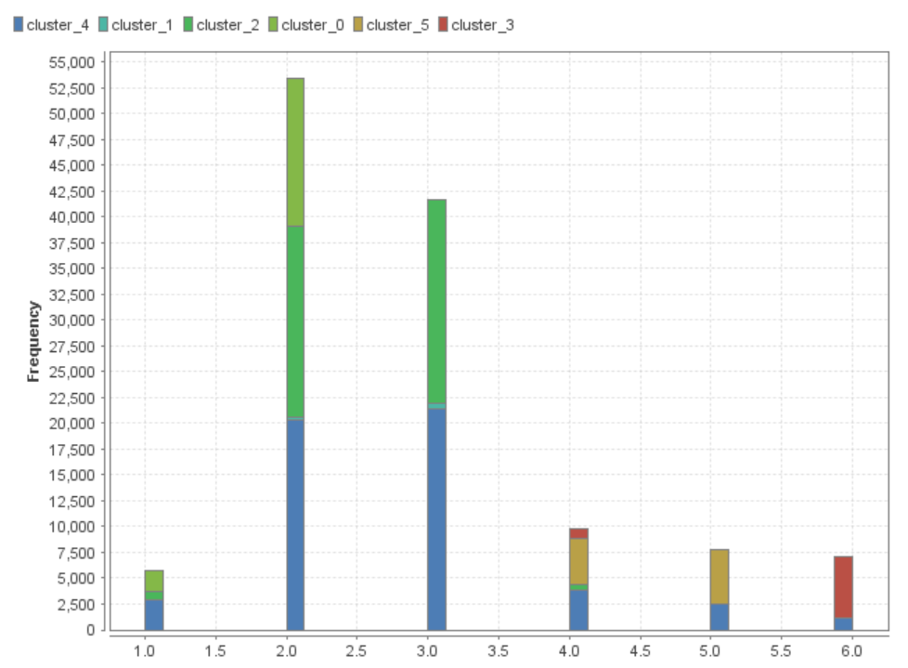
Rapidminer
PCA k-means clustering

Slide 20
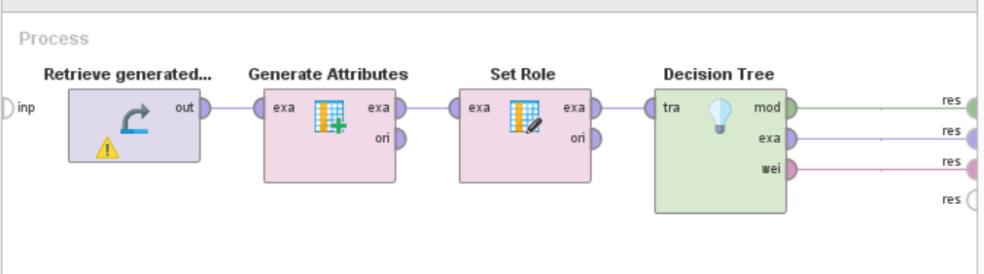
Rapidminer
decision tree

Slide 21
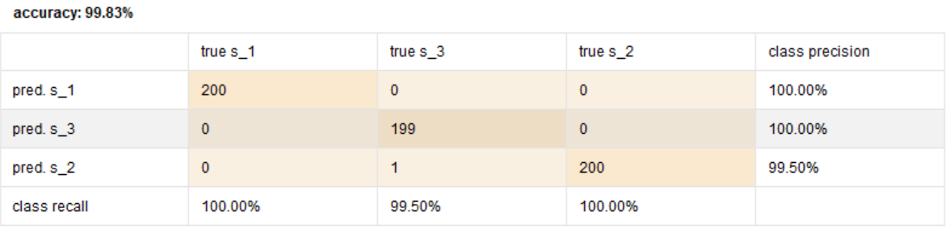
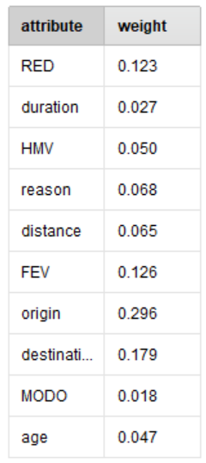
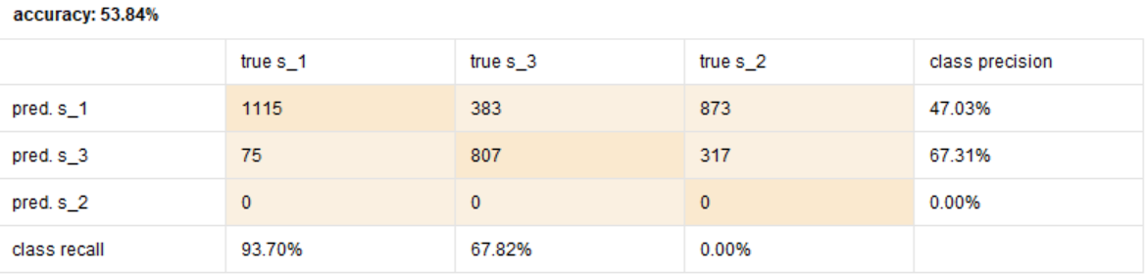
Rapidminer
decision tree
Notes:
Weights from the good one

Slide 22
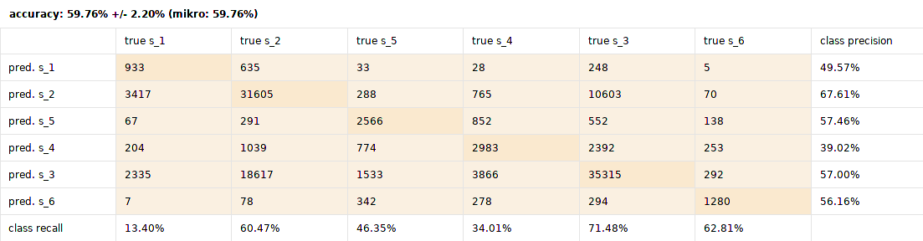
Neural Net
original data:
(in roughly 25 minutes)
Notes:
All other was not satisfactory
Try to train a NN
(not vector data)

Slide 23
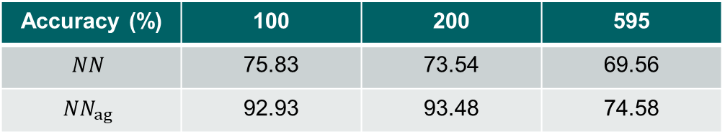
Neural Net
person vector data:
Architecture:
4 Hidden Layers
10 neurons each
Why? Others were worse
What does that tell us? no clear correlation larger set leads to higher variance
Accuracy (%) | 100 | 200 | 595
$$NN$$ | 75.83 | 73.54 | 69.56
$$NN_{ag}$$ | 92.93 | 93.48 | 74.58
Notes:
10-fold cross validated

Slide 24

Result
Not reproducable – Why?
Representative working day
People living over/under standards
Individuality of lifestyle
Complete inverse behavior in same strata
No observable clusters
Next Steps:
Analyse most important aspects of DT and NN
network representation
Notes:
NOT SAY HIPSTER Idiot!
We need more information to explain the strata -> summarize

Slide 25
Result
WE NEED MORE INFORMATION

Slide 26
Fin.
Thank you for your attention
Notes:
One slide with: we need more information!

Slide 27
TODOs
Possible additions
calculate proportions of MED und G-Dist to show equal outcome
Through PCA just 2 components. Maybe therefore 2 Cluster?
Analyse most important aspect of DT and NN
Distribution of values within one strata !!
Maybe use networkx
Questions towards María:
Should we explain: k-means?
Notes:
Future work 3 and 5

